Slide 1


CAPSTONE
PROJECT
BY:
Ayush Sharma and Devendra Pratap Singh

Slide 2
PROBLEM STATEMENT
The Capacitated Vehicle Routing Problem (CVRP) refers to the process of determining the optimal route for a fleet of vehicles to deliver goods to customers while fulfilling various constraints.
The objective of the CVRP is to find optimal routes to deliver goods to customers while minimizing the total distance traveled, time taken, or cost incurred. The problem is typically solved using optimization techniques such as heuristics and exact methods.

Slide 3
SOLUTION
Exact, heuristic, and meta-heuristic methods can all be used to solve the CVRP. Heuristic and meta-heuristic methods use algorithms that can quickly produce a solution that is close to optimal, while exact methods solve the problem using mathematical programming techniques.
That is why we chose the Genetic algorithm, a search heuristics based on human evolution.

Slide 4
TECH STACK & ALGO
Flask
Python Integration :Given that the Genetic Algorithm is implemented in Python, Flask provides a natural integration platform, leveraging the existing Python ecosystem for development and deployment.
React
Enhanced user experience with interactive interfaces.
Real-time updates for dynamic optimization results.
Powerful state management for handling user interactions.
Genetic Algorithm
Efficient optimization inspired by natural selection.
Adaptability to diverse problem domains.
Scalability and parallel processing capabilities.

Slide 5
TIMELINE
How our Work Proceeded
1
2
3
4
5
6
GENETIC ALGO
ADDED CAPACITY
FRONTEND
INTEGRATION
ROUTES SHOW
PRESENT
Implemented GA without any capacity constraint, assuming capacity to be infinite.
Using React, designed a webpage where users can input source and destination points.
Integrated our frontend interface with the backend GA via Flask.
Vehicles along with their routes are shown on Map
Final Solution
Extended GA to incorporate capacity constraints for assigned vehicles.

Slide 6


BACKEND
Implementing endpoints in Flask to expose genetic algorithm functionalities such as:
Sending parameters and receiving solutions.
Retrieving status updates on the optimization process.
Serialization and Deserialization: Overview of serialization techniques (e.g., JSON) for converting genetic algorithm solutions and parameters into a format that can be transmitted over HTTP.
Handling Genetic Algorithm Requests: Explanation of how Flask routes incoming requests to appropriate genetic algorithm functions.
Error Handling and Validation: Techniques for implementing error handling and validation in Flask to ensure robustness and security of the backend.

Slide 7
CHALLENGES
Constraint Handling: Enforcing constraints such as vehicle capacity, time windows, and precedence constraints adds complexity to the algorithm.
Crossover and Mutation Operators: Designing effective crossover and mutation operators that balance exploration and exploitation is challenging. The operators should facilitate the creation of diverse offspring while preserving the good characteristics of the parent solutions.
Parameter Tuning: Genetic algorithms typically have several parameters, such as population size, crossover rate, mutation rate, and selection mechanisms. Tuning these parameters to achieve optimal performance across different problem instances can be time-consuming and requires experimentation.
Runtime Efficiency: As the size of the problem instance increases, the computational complexity of the genetic algorithm also grows. Ensuring the algorithm is computationally efficient and capable of handling large-scale instances within reasonable time limits is important.
Benchmarking and Validation: Ensuring that the algorithm consistently produces high-quality solutions across different problem instances is essential.

Slide 8
GENETIC ALGO
Initialization:
Generates a population of solutions representing vehicle routing configurations with capacity constraints, constructing routes by random destination allocation while respecting capacity limits.
Selection:
Randomly selects subsets of individuals (tournaments) from the population.
Chooses the best individual based on fitness within each tournament as a parent.
Crossover:
Selects parents from the population and determines a random crossover point.
Combines segments of routes from both parents at the crossover point to create offspring, facilitating genetic information exchange.
Mutation:
Utilizes swap mutation by randomly selecting two elements within a route and exchanging their positions.

Slide 9
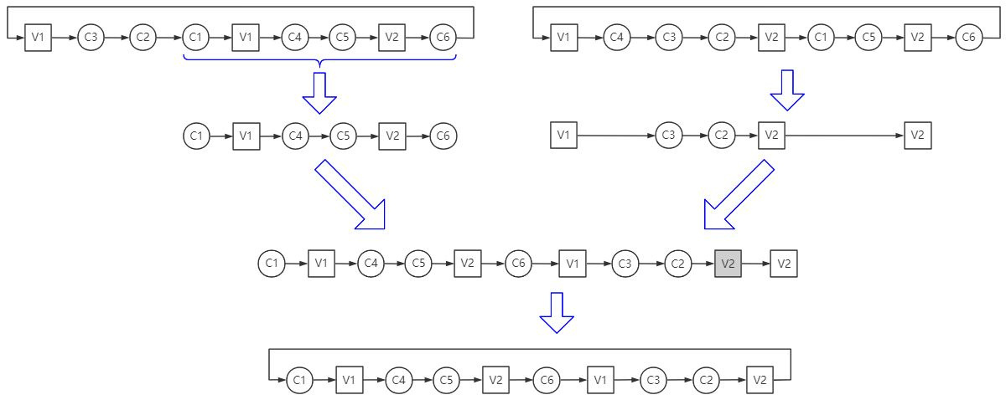
CROSSOVER

Slide 10
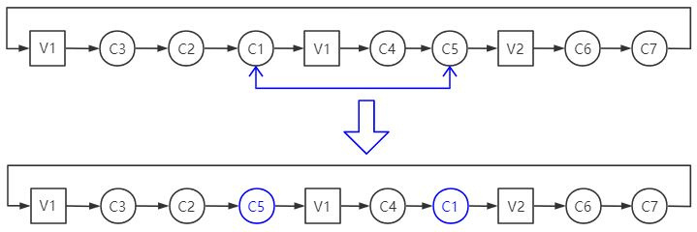
Swap Mutation
3
3

Slide 11
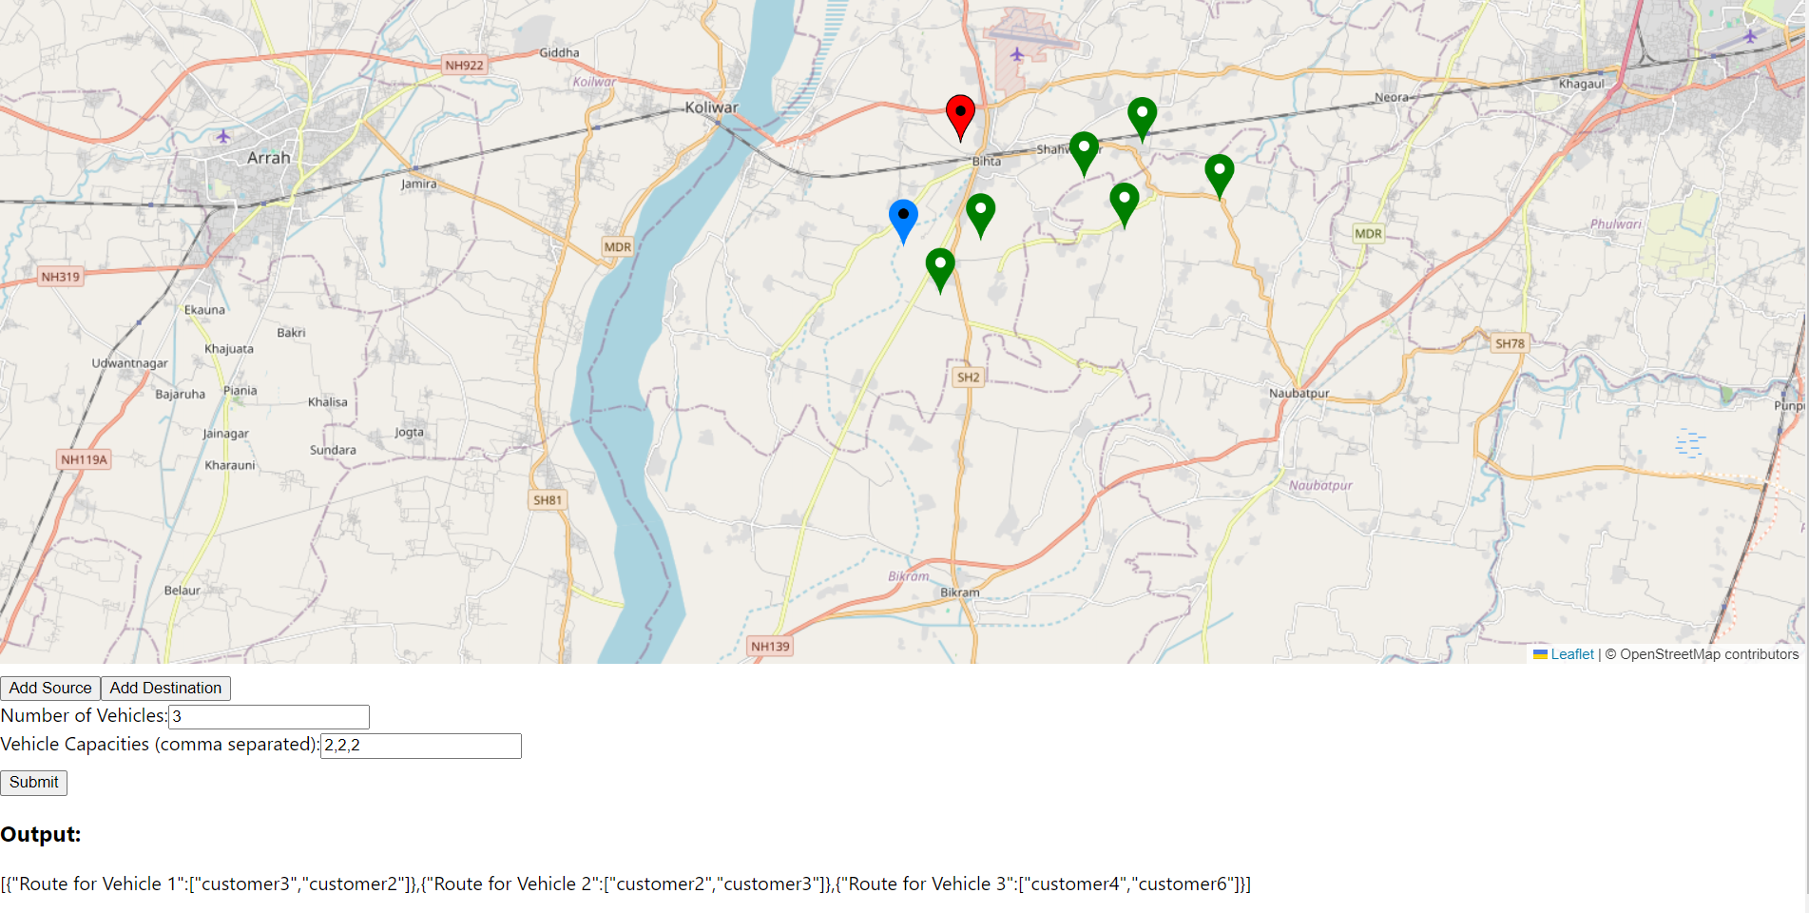
CHALLENGE

Slide 12
FRONTEND
Made an interactive UI with React utilising Leaflet library, showing our current location too.
Stored the Source Points and Destination Points taken as input by the user.
Number of Vehicles and the Capacities of Vehicles form added.
On clicking Submit, the vehicles along with the optimised routes taken by them shown on Map.
Color code for each vehicle is also shown.

Slide 13
LET’S GET IT WORKING

Slide 14
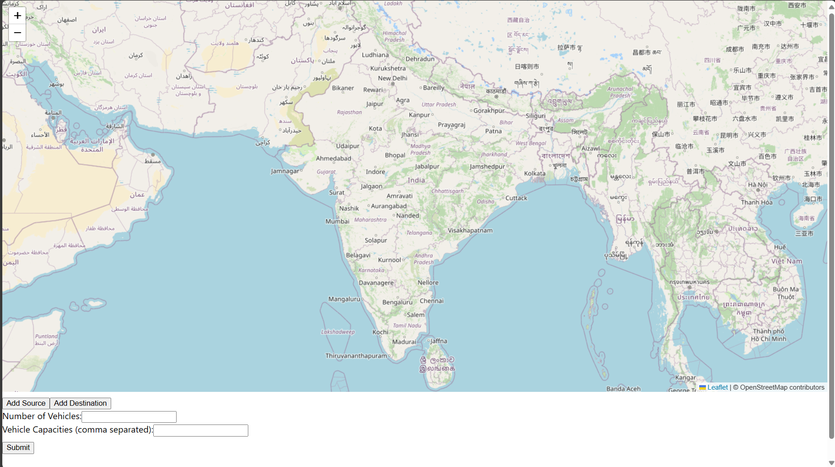

Slide 15
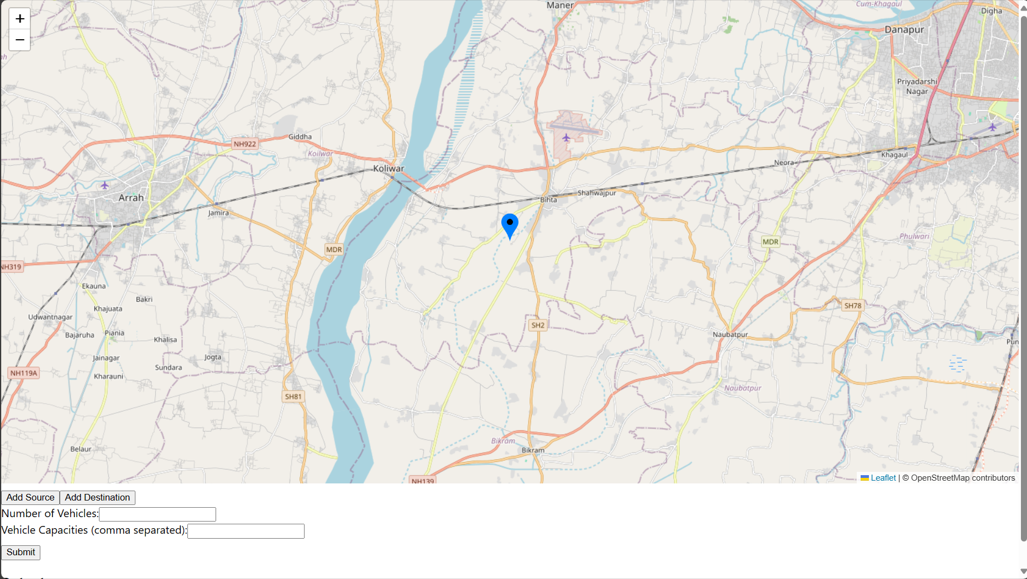
MY LOCATION

Slide 16
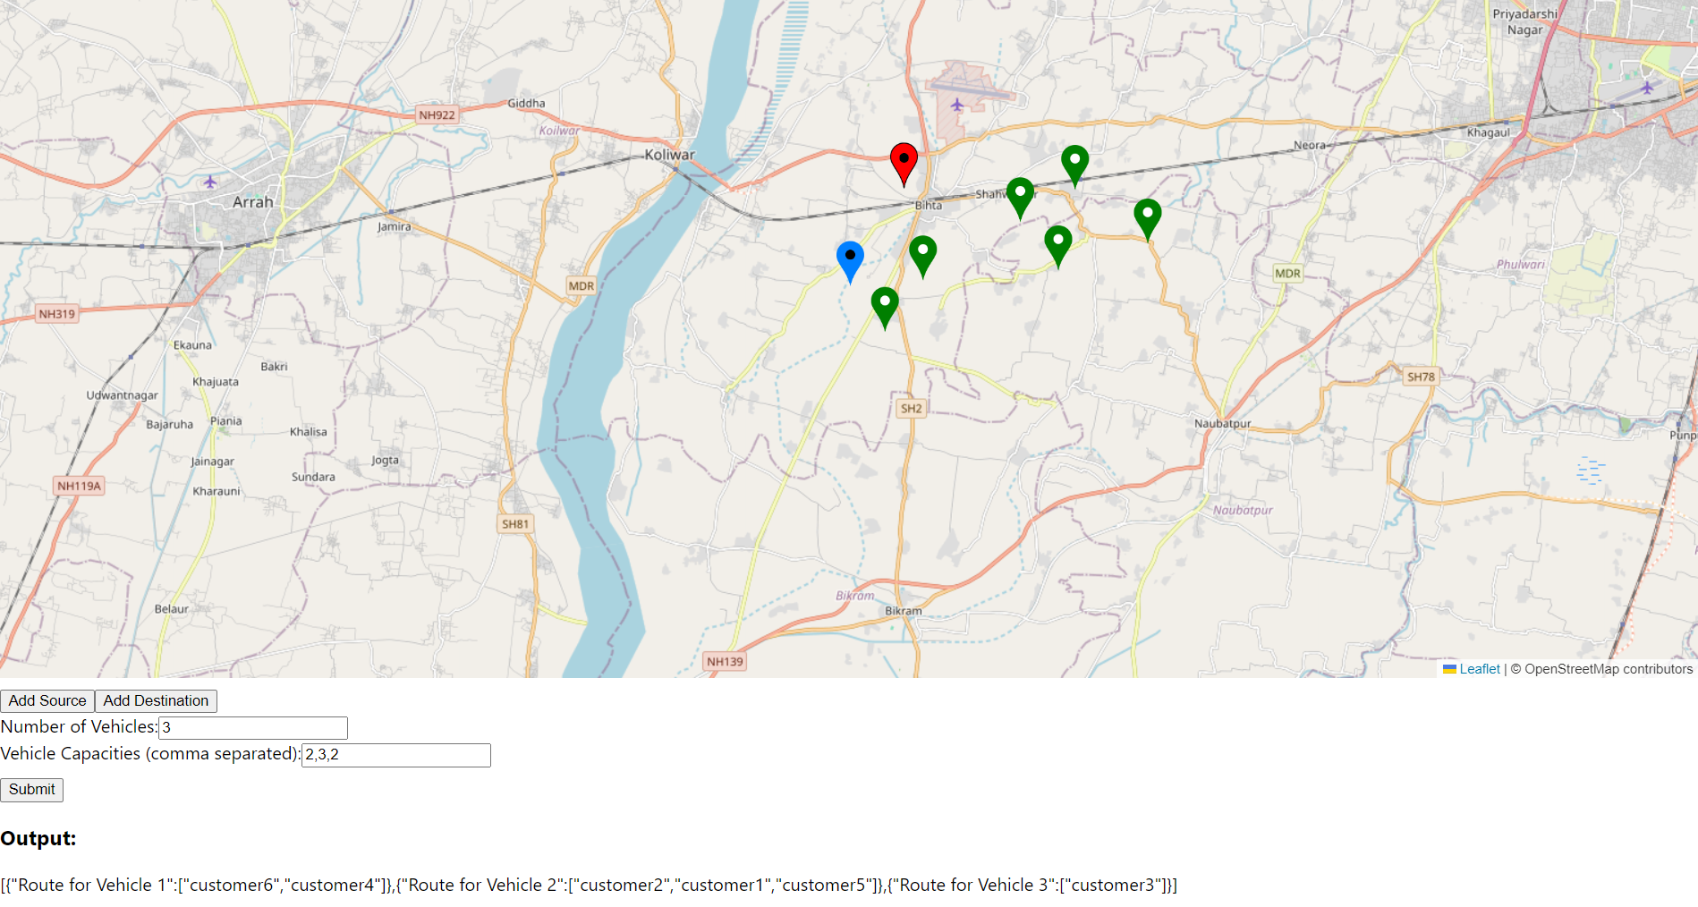

Slide 17
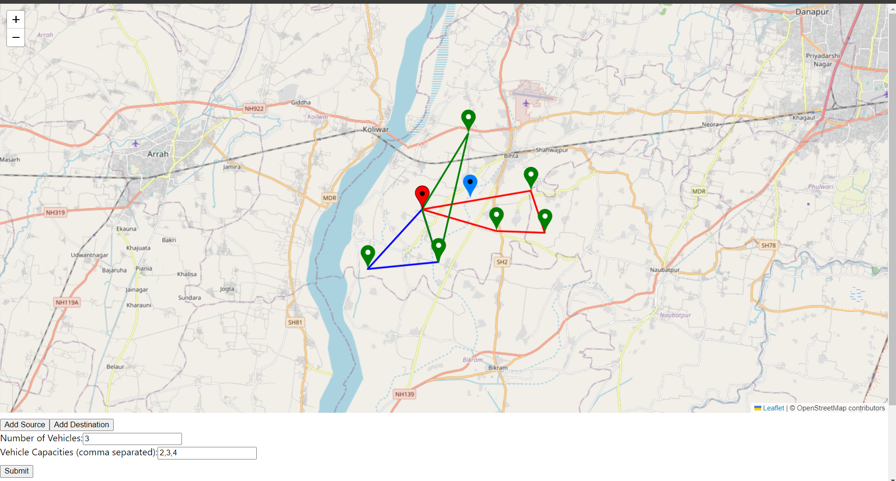

Slide 18
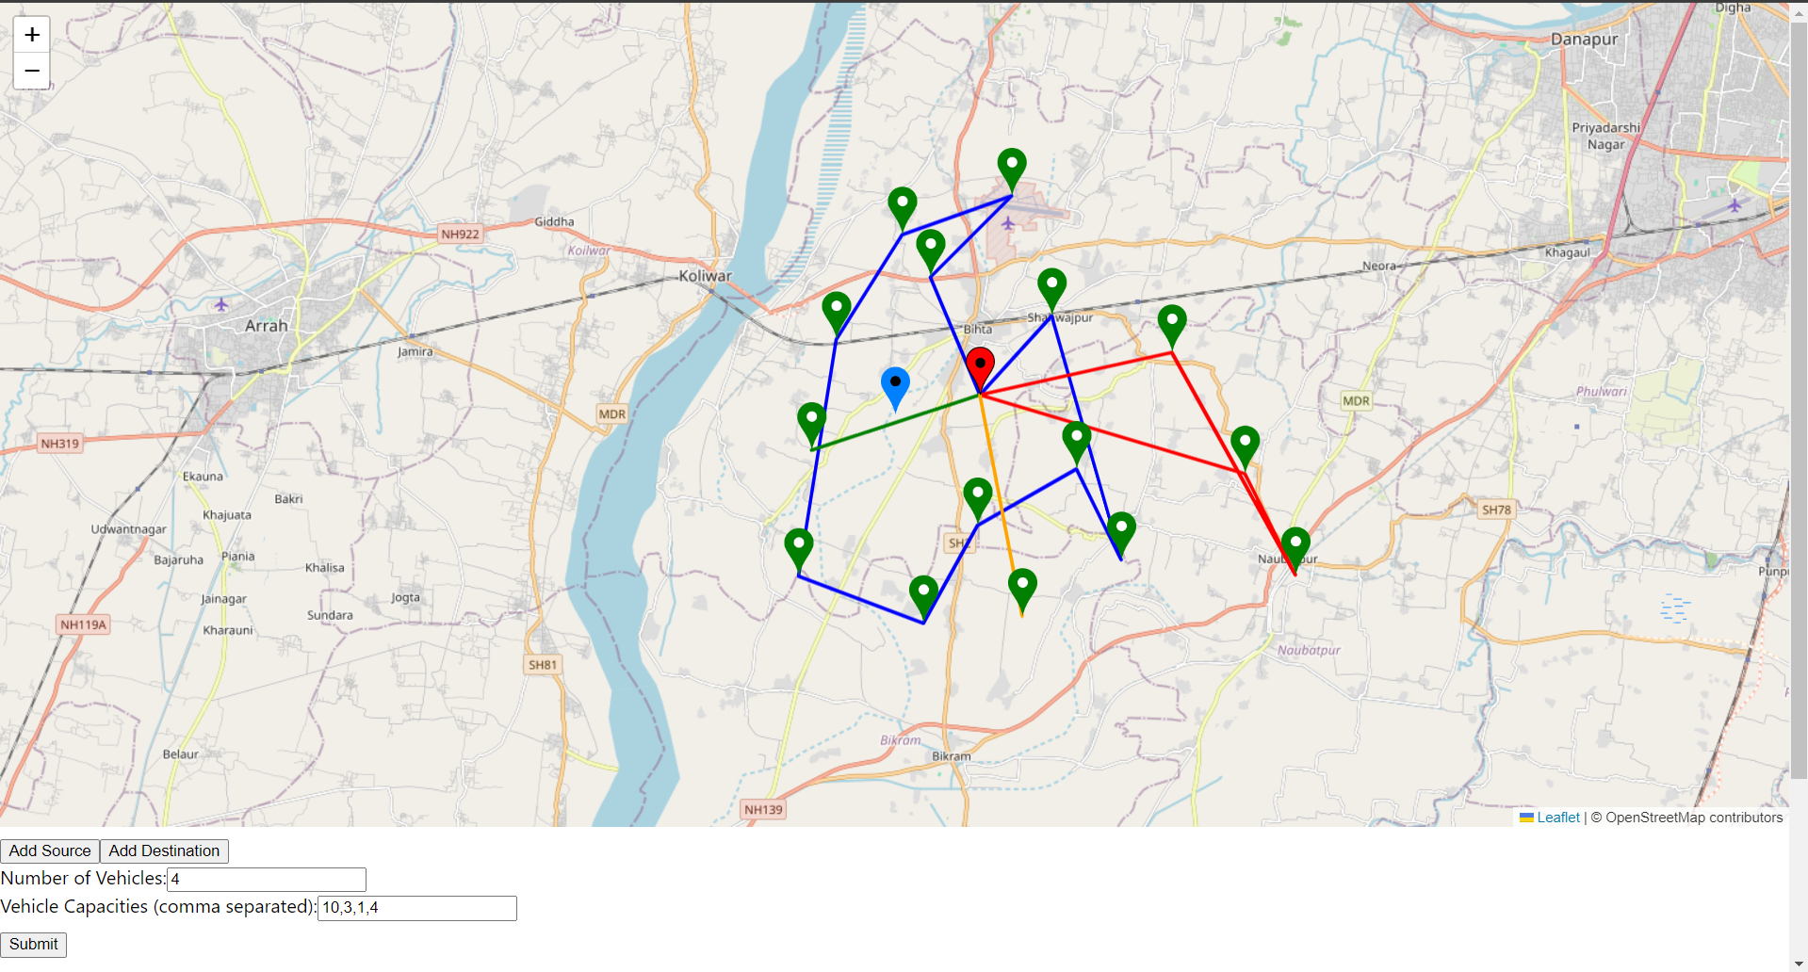

Slide 19
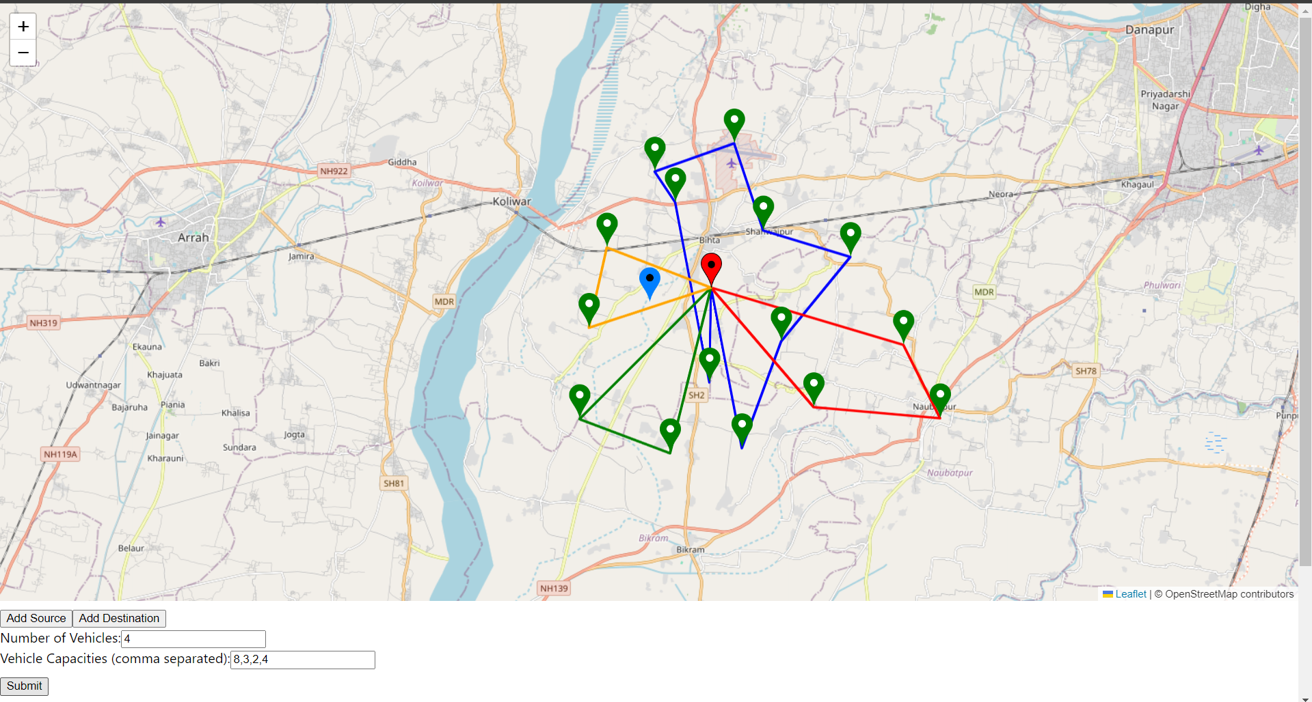

Slide 20
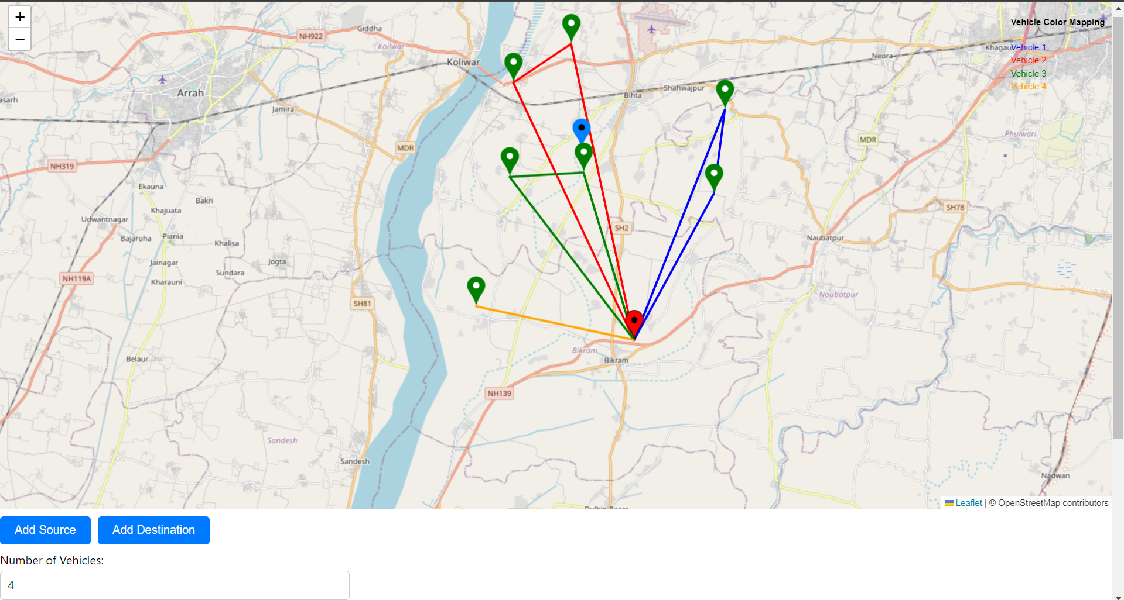
IMPROVED UI

Slide 21
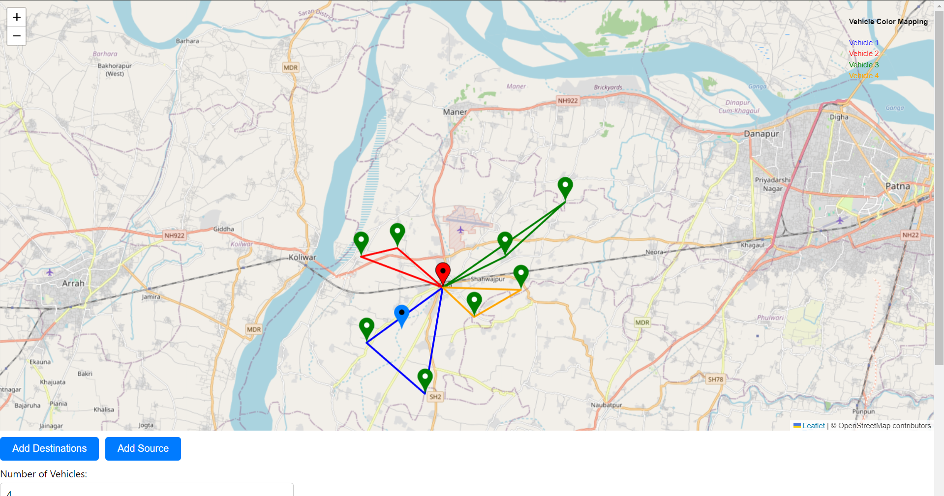

Slide 22



Improving code quality
FUTURE
PLANS
Time window for users
Multi Depot

Slide 23
TEAM CONTRIBUTION
Backend - Ayush
Frontend - Devendra
Integration - BOTH

